Slide 1

COVID-19 Charts with Python
Individual Project made by Vodă Darian-Florian

Slide 2
CONTENTS
This presentation contains:
-Introduction of the project
-Description of the process
-Conclusions

Slide 3
Introduction
The main idea of the project is to gather information from online and create interesting charts

Slide 4
01
02
WEB SCRAPING
CHARTS
03
04
ANALYSIS
CONCLUSION
IMPORTANCE
With this project, I found a way of getting data from internet with Python
Another important aspect, is that I have learned how to create insightful charts
The scope of the project is also to research and analyze the data that you have obtained
And after all these steps you should derive to a conclusion that could help your team

Slide 5
Description of the process

Slide 6
Steps
As I mentioned, the key steps of this project are the following:
Gather the data from internet using Python libraries (e.g. BeautifulSoup)
Save the data into a file (e.g. CSV) and preprocess it
Create charts based on your data
Derive to conclusions

Slide 7
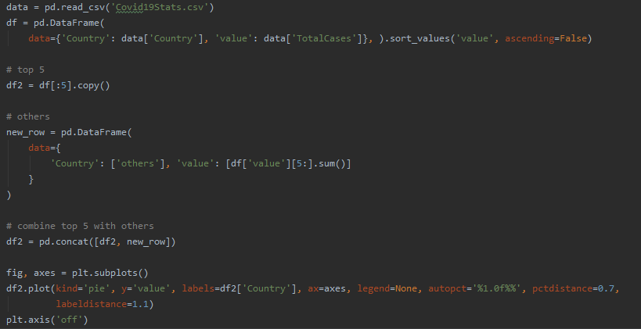
Parts of Code
In this code we are doing the following:
Read the data from CSV file using Pandas library
Create a new Data Frame with Countries and the value that we want to analyze
Copy the Top 5 countries in a variable
The rest of the countries are copied in new_row variable
We concatenate the Top 5 countries with the rest of them
Create a Pie chart of the Top 5 countries in the world based on Total Cases of COVID-19

Slide 8

Conclusions
In this project I have stepped out of my comfort zone in order to learn how to web scrape, create charts and use some basic stuff from libraries like Pandas, NumPy, Matplotlib and others.

Slide 9
THANK YOU!
Do you have any questions?

